Slide 1
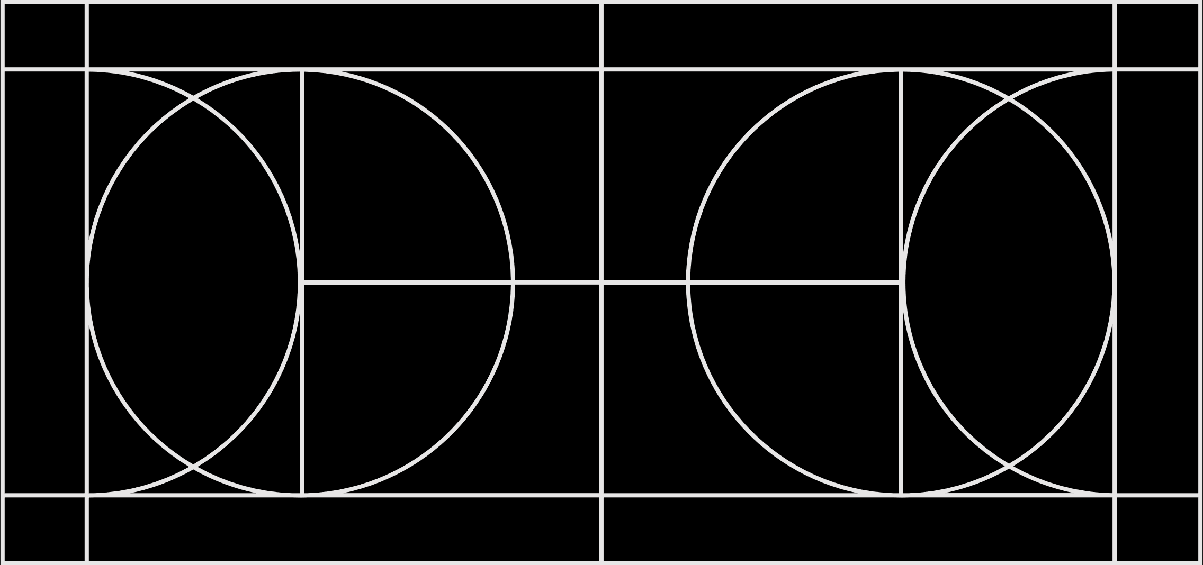
Heuristic Method

Slide 2
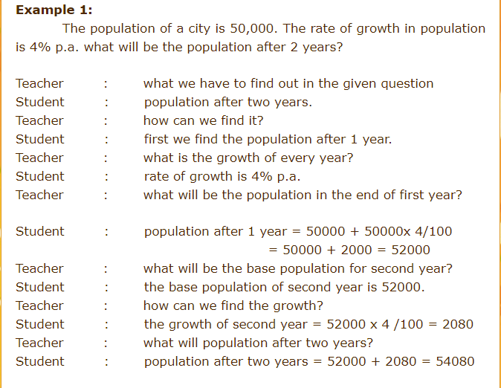
Example

Slide 6
Problem Solving Method

Slide 7
STEPS

Slide 11
Method Vs Technique

Slide 12
Techniques of Teaching Mathematics

Slide 13
Oral Work

Slide 14
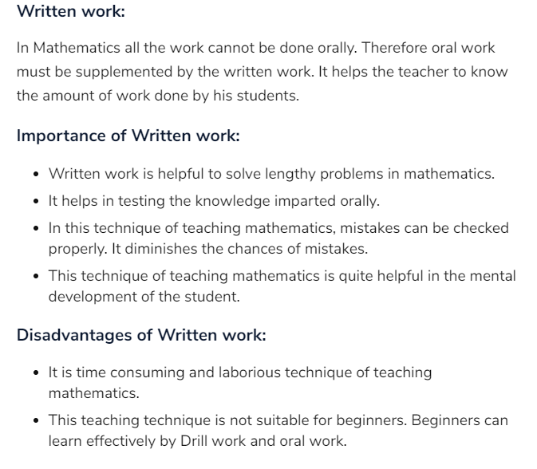
Written Work

Slide 15
Drill Work

Slide 16
Self Study

Slide 17
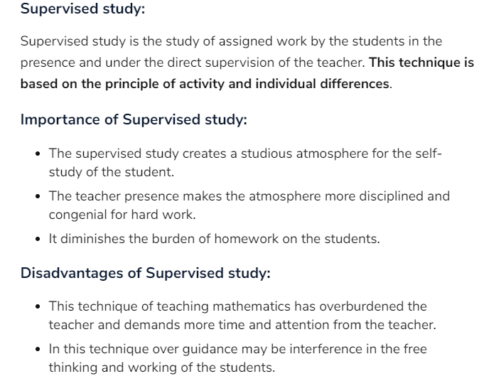
Supervised Study

